Slide 1
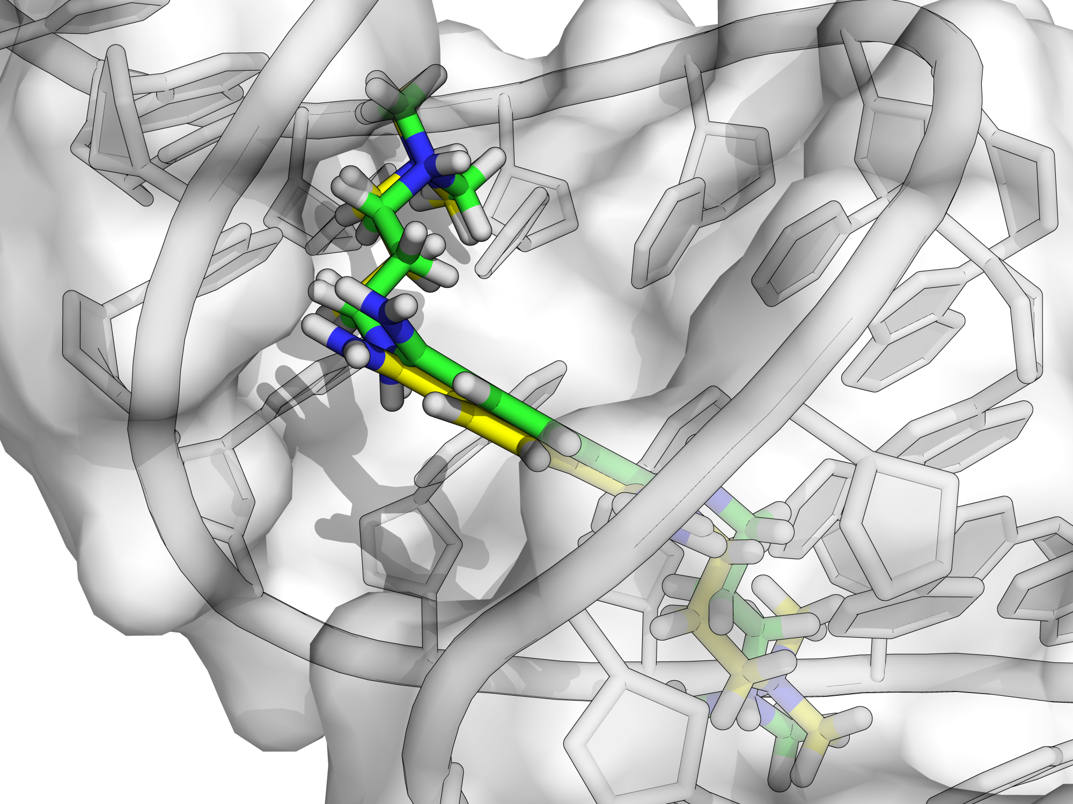

Discriminating Native from Non-Native RNA Structure Using Unassigned Chemical Shift Data Toward Rapid RNA Structure Elucidation
Aaron T. Frank
Assistant Professor of Biophysics
Assistant Professor Chemistry
Notes:
As the title slide indicates, today I’ll try to take stock of the field of RNA Drug Discovery, in particular structure-based RNA drug discovery. In the case of proteins, this approaches has enabled many drugs to be discovered that “successfully” treat a wide range of diseases. In contrast, RNA drug discovery is a relatively young field.

Slide 2

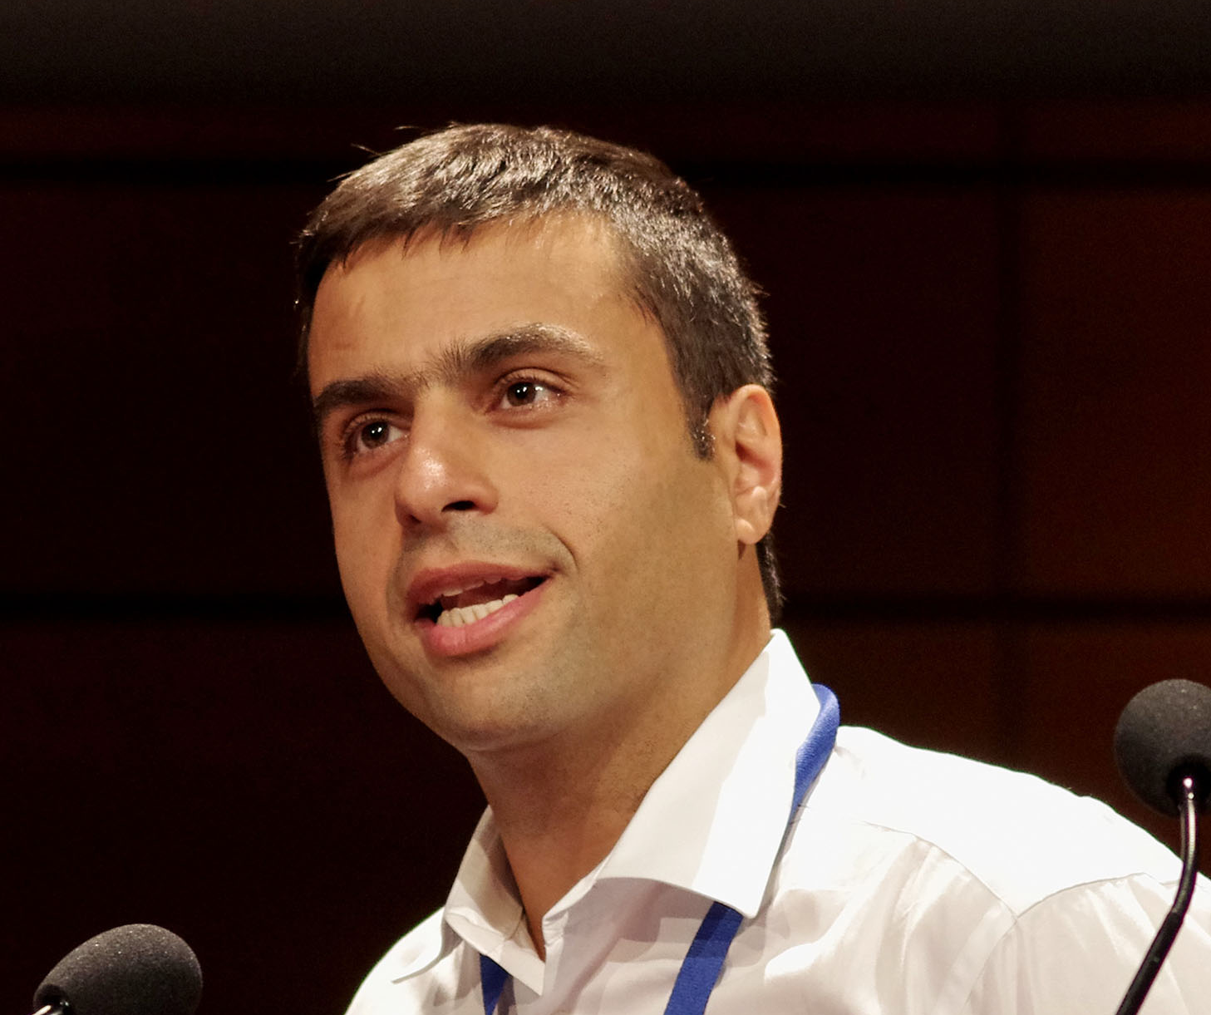
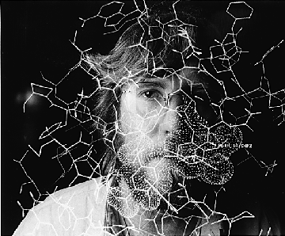
Scientist Lineage
Ioan Andricioaei
Theoretical and Computational Chemist
(Ph.D advisor)
Hashim M. Al-Hashimi
Biomolecular NMR
(Graduate School Collaborator)
Charles L. Brooks, III
Theoretical and Computational Chemist
(Postdoc Advisor and Mentor)
Notes:
As I The first aim I describe addresses this need.

Slide 3
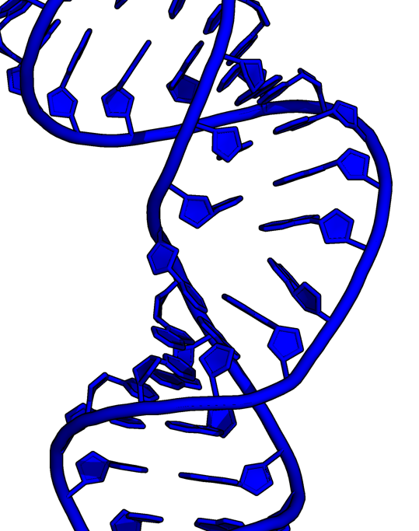

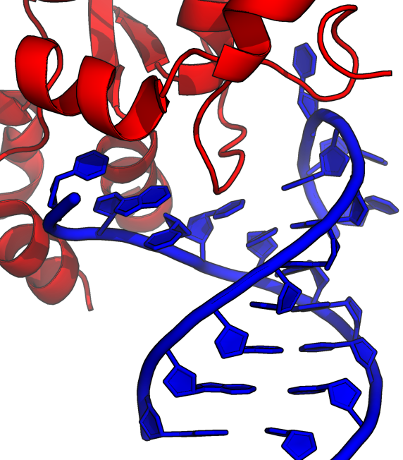
Understand how ribonucleic acids, either by themselves or in concert with other molecules, achieve specific cellular functions.
RNA only
RNA-Small Molecule
Complex
RNA-Protein
complex
Notes:
As the title slide indicates, today I’ll try to take stock of the field of RNA Drug Discovery, in particular structure-based RNA drug discovery. In the case of proteins, this approaches has enabled many drugs to be discovered that “successfully” treat a wide range of diseases. In contrast, RNA drug discovery is a relatively young field.

Slide 4
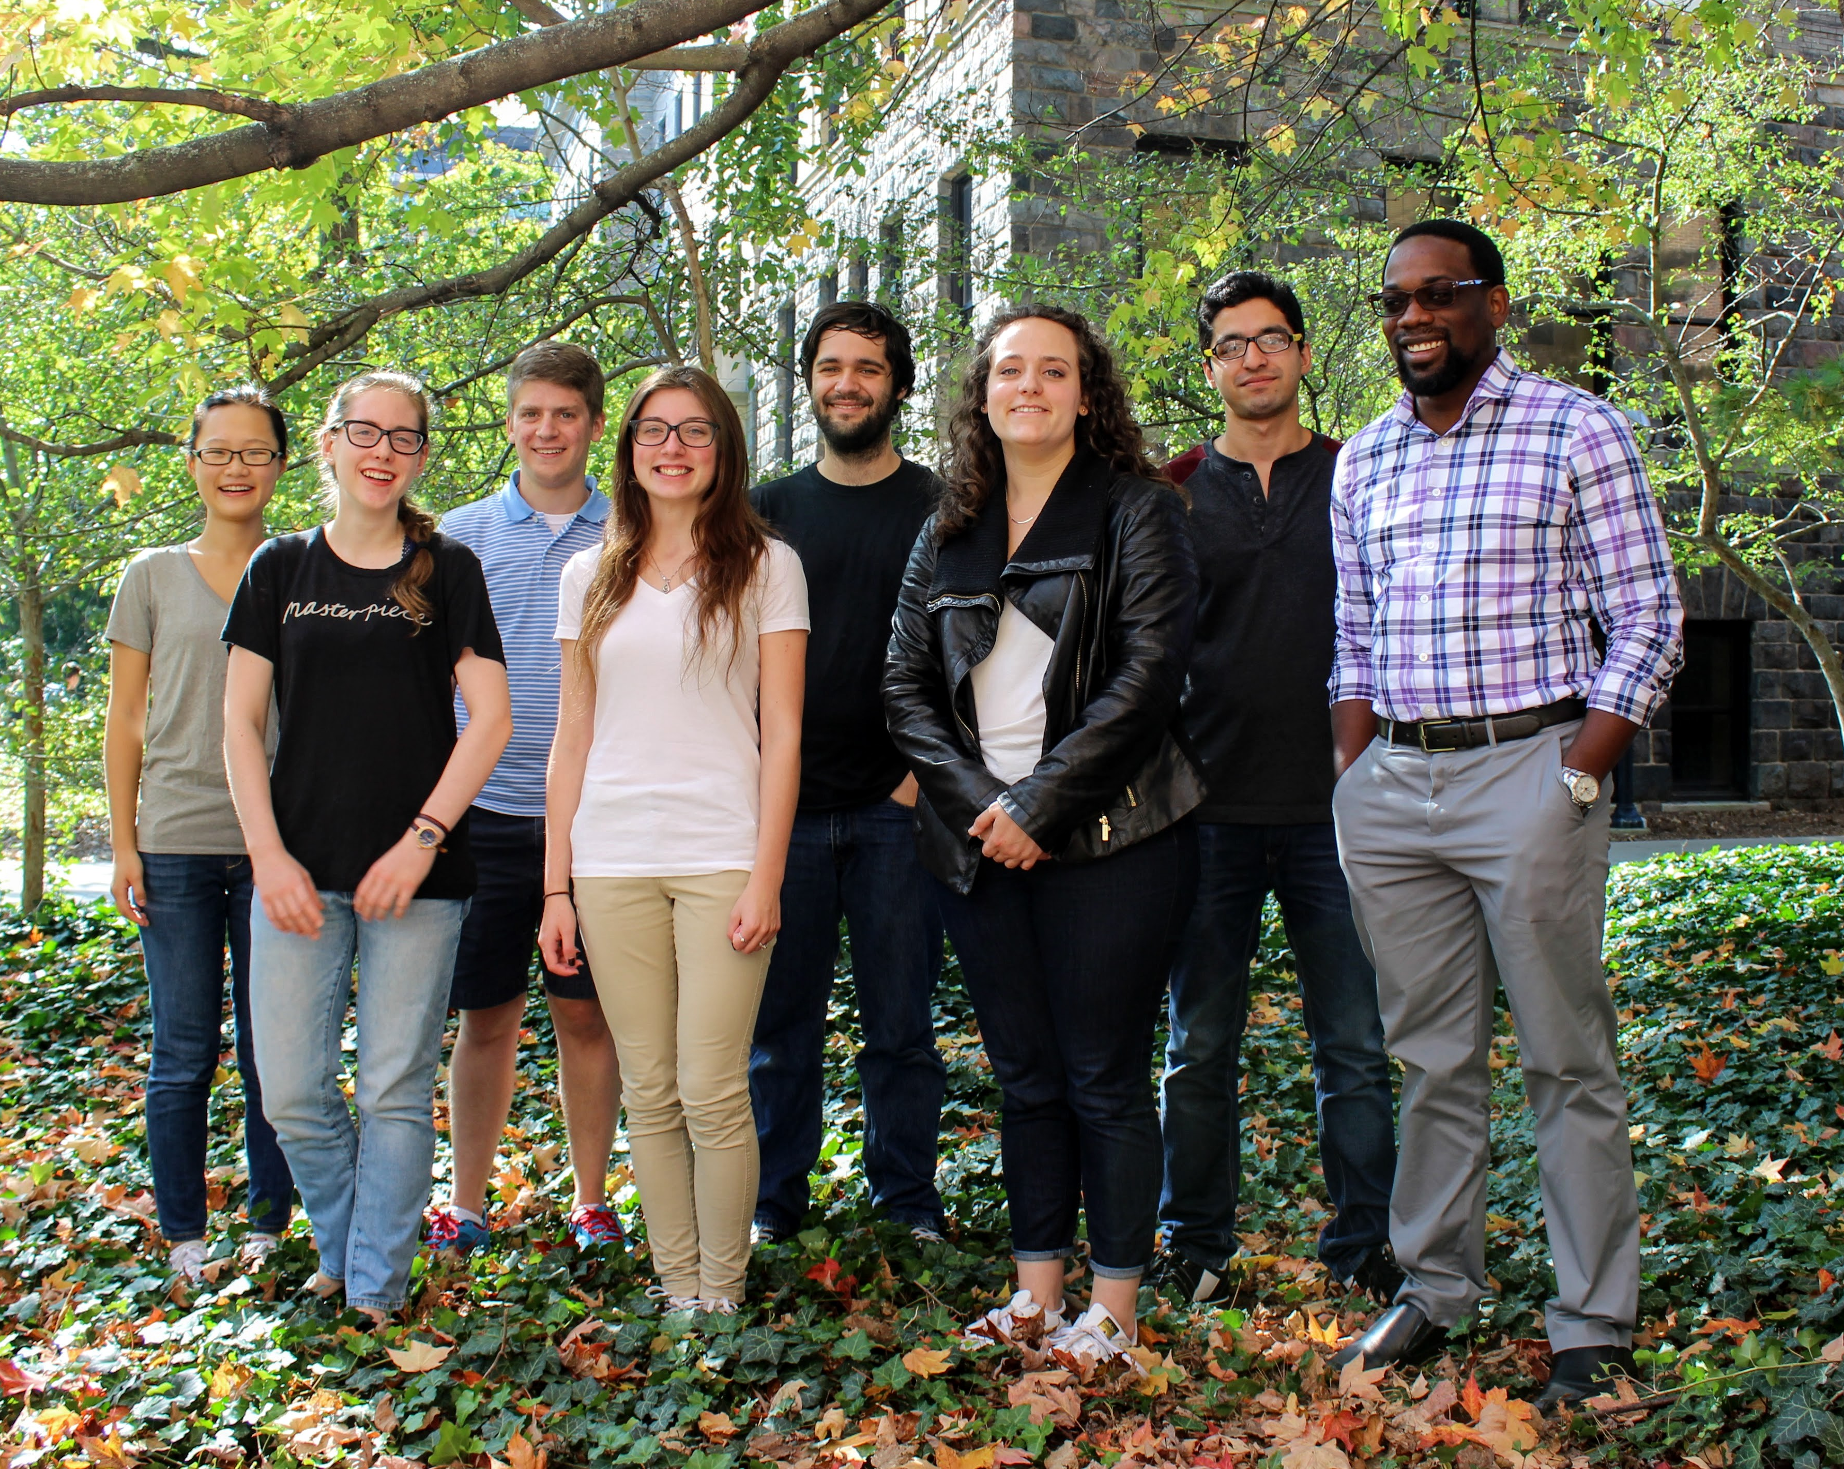
Structure Prediction and Molecular Simulations
Notes:
As the title slide indicates, today I’ll try to take stock of the field of RNA Drug Discovery, in particular structure-based RNA drug discovery. In the case of proteins, this approaches has enabled many drugs to be discovered that “successfully” treat a wide range of diseases. In contrast, RNA drug discovery is a relatively young field.

Slide 5
Challenge: Going From Sequence to Atomic Models
…GGAUUCGCGAAUC…
(RNA Sequence)
(RNA 3D Structure)

Slide 6
Going From Sequence to Atomic Models
(via Integrative Modeling and Simulations)
sm-FRET
Footprinting
Mass Spec
Cross-Linking
Cryo-EM
Circular Dichroism
RNA Structure
NMR
SAXS

Slide 7
Going From Sequence to Atomic Models
(via NMR-based Integrative Modeling)
sm-FRET
Footprinting
Mass Spec
Cross-Linking
Cryo-EM
Circular Dichroism
RNA Structure
NMR
SAXS

Slide 8
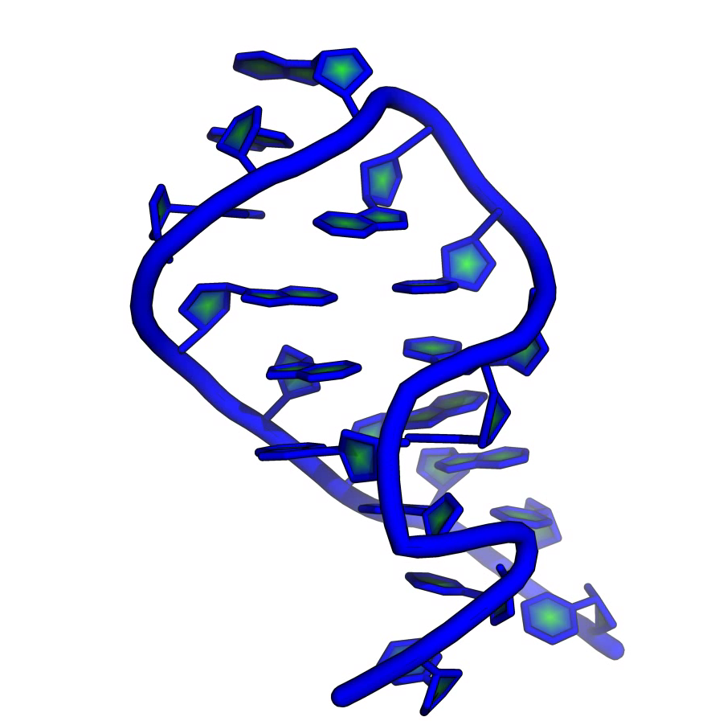
Using Chemical Shifts As “Structural Signatures”
Readily Accessible
Sensitive to Stacking
Precisely and Accurately Measured
Sensitive to Base-Pairs
Site Specific
Sensitive Local Charges

Slide 9
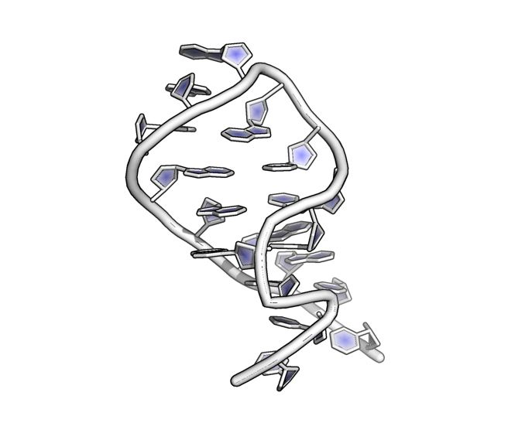
From Structure to Chemical Shifts
G | 1 | C1' | 89.2
G | 2 | C1' | 90.2
G | 3 | C1' | 90.6
U | 4 | C1' | 90.8
G | 5 | C1' | 89.9
C | 6 | C1' | 91.4
U | 7 | C1' | 92.3
C | 8 | C1' | 89.2
A | 9 | C1' | 85.5
G | 10 | C1' | 81.3
• | • | • | •
• | • | • | •
• | • | • | •
• | • | • | •
RAMSEY
(Machine-Learning)
LARMOR^{D}
(Genetic Algorithm)
Phys. Chem. B, 2013
J. Phys. Chem. B, 2014

Slide 10
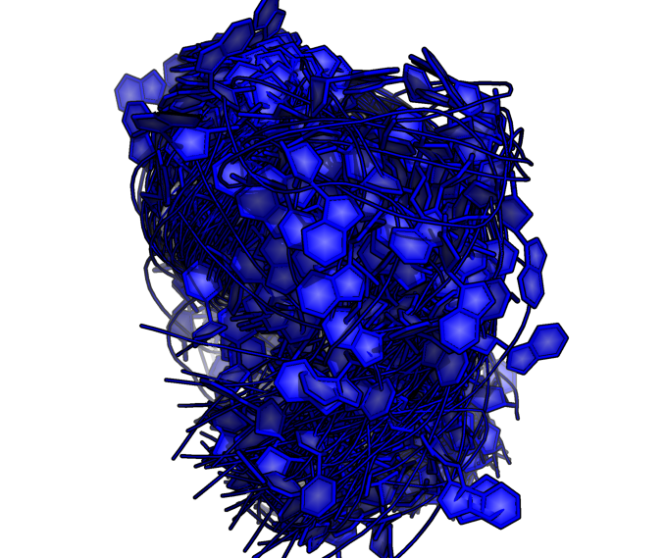
Going From Sequence to Atomic Models
(via Assigned Chemical Shifts)
…GGAUUCGCGAAUC…
RNA Sequence
(1) Structure prediction tools (e.g., Rosetta)
(2) Filter with
Assigned Chemical Shifts
(e.g., LARMOR^{D}, RAMSEY)

Slide 11
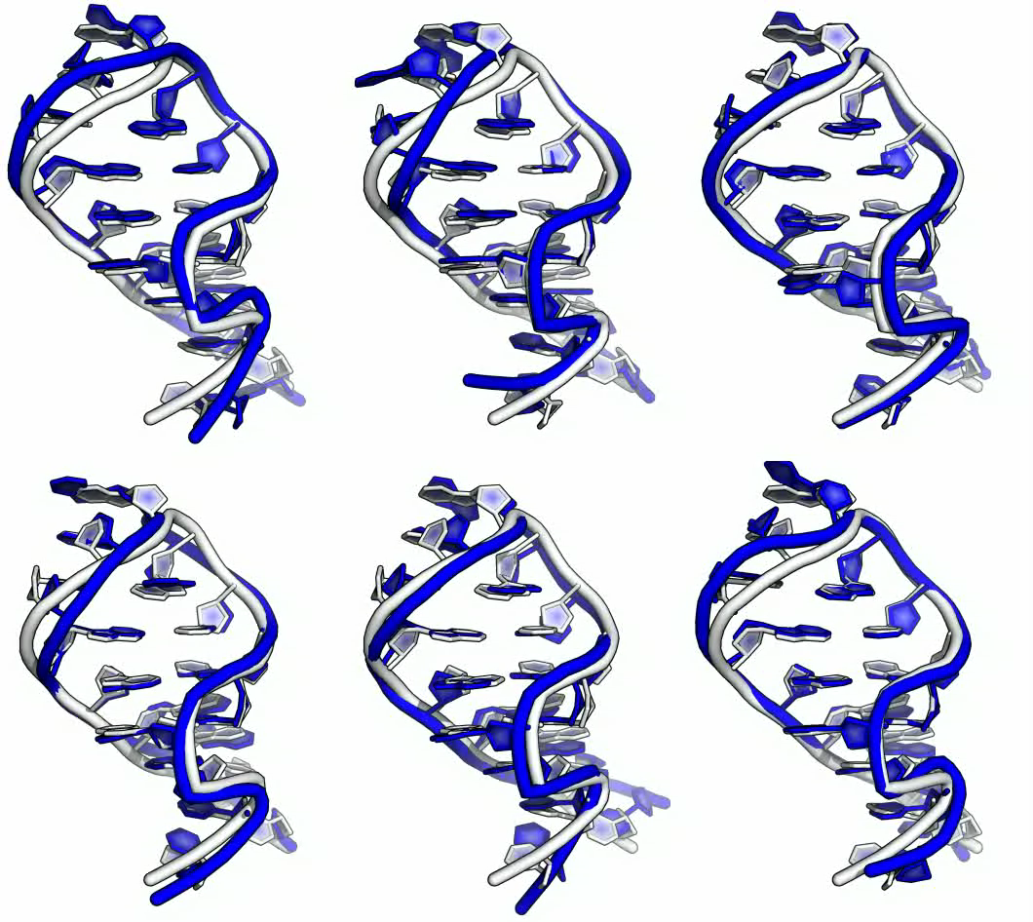
Going From Sequence to Atomic Models
(via Assigned Chemical Shifts)
Predicting Structure of Small RNA Motifs Using ¹H CS (CS-Rosetta): Das and Coworkers, Nature Methods, 2014
Predicting Structure of Helices—Including Those Containing Non-Canonical Basepairs— Using ¹H CS: Wijmenga and coworkers, JBNMR, 2015

Slide 12
Using Assigned Chemical Shifts, Comparison Is Straightforward
G | 1 | C1' | 89.2
G | 2 | C1' | 90.2
G | 3 | C1' | 90.6
U | 4 | C1' | 90.8
G | 5 | C1' | 89.9
C | 6 | C1' | 91.4
U | 7 | C1' | 92.3
C | 8 | C1' | 89.2
A | 9 | C1' | 85.5
G | 10 | C1' | 81.3
• | • | • | •
• | • | • | •
• | • | • | •
• | • | • | •
89.3
91.0
90.7
89.3
87.9
92.3
94.5
90.7
87.2
80.0
•
•
•
•
Exp. Assigned NMR
Peaks
Sim. Assigned NMR
Peaks
We know the mapping between:
observed chemical shift peaks and nuclei
(consequently) observed and computed

Slide 13
Not So Straightforward Using Unassigned Chemical Shifts
? | ? | ? | 89.2
? | ? | ? | 90.2
? | ? | ? | 90.6
? | ? | ? | 90.8
? | ? | ? | 89.9
? | ? | ? | 91.4
? | ? | ? | 92.3
? | ? | ? | 89.2
? | ? | ? | 85.5
? | ? | ? | 81.3
? | ? | ? | •
? | ? | ? | •
? | ? | ? | •
? | ? | ? | •
?
?
?
?
?
?
?
?
?
?
•
•
•
•
Exp. Unassigned NMR
Peaks
Sim. Assigned NMR
Peaks
We don’t know the mapping between:
observed chemical shift peaks and nuclei
observed and computed

Slide 14
The “Computational” Assignment Problem
? | ? | ? | 89.2
? | ? | ? | 90.2
? | ? | ? | 90.6
? | ? | ? | 90.8
? | ? | ? | 89.9
? | ? | ? | 91.4
? | ? | ? | 92.3
? | ? | ? | 89.2
? | ? | ? | 85.5
? | ? | ? | 81.3
? | ? | ? | •
? | ? | ? | •
? | ? | ? | •
? | ? | ? | •
G | 1 | C1' | 89.2
G | 2 | C1' | 90.2
G | 3 | C1' | 90.6
U | 4 | C1' | 90.8
G | 5 | C1' | 89.9
C | 6 | C1' | 91.4
U | 7 | C1' | 92.3
C | 8 | C1' | 89.2
A | 9 | C1' | 85.5
G | 10 | C1' | 81.3
• | • | • | •
• | • | • | •
• | • | • | •
• | • | • | •
Unassigned Peak List
Fully Assigned Peak List

Slide 15
Structure-Based Assignment
Computed From
Structure
Optimally
Assigned
G | 1 | C1'
G | 2 | C1'
G | 3 | C1'
U | 4 | C1'
G | 8 | C1'
C | 6 | C1'
U | 7 | C1'
C | 12 | C1'
A | 9 | C1'
G | 10 | C1'
• | • | •
• | • | •
• | • | •
• | • | •
89.3
91.0
90.7
89.3
87.9
92.3
94.5
90.7
87.2
80.0
•
•
•
•
89.2
90.2
90.6
90.8
89.9
91.4
92.3
89.2
85.5
81.3
•
•
•
•
Sim. NMR
Peaks
Rosetta: Baker and Coworkers, PNAS, 2003
SCLOUDS: Llinás and coworkers, JACS, 2008
COMPASS: Rienstra and coworkers, Structure, 2015
Optimally map computed to observed by minimizing their difference
SCAHA: Structure-Based Chemical Shift Assignment via Hungarian Algorithm

Slide 16
Results: SCAHA Accuracy (over test set of 52 RNAs)
LARMOR^{D} Accuracy
¹H: 0.17 ppm; ¹³C: 0.81 ppm
RAMSEY Accuracy
¹H: 0.15 ppm; ¹³C: 0.83 ppm

Slide 17
Results: SCAHA Accuracy (over test set of 52 RNAs)

Slide 18
1.0: Going From Sequence to Atomic Models
(via Assigned Chemical Shifts)
…GGAUUCGCGAAUC…
RNA Sequence
(1) Structure prediction tools (e.g., Rosetta)
(2) Filter with
Assigned Chemical Shifts
(e.g., LARMOR^{D}, RAMSEY)

Slide 19
2.0: Going From Sequence to Atomic Models
(via Unassigned Chemical Shifts)
…GGAUUCGCGAAUC…
RNA Sequence
(1) Structure prediction tools (e.g., Rosetta)
(2) Filter with
Assigned Chemical Shifts
(e.g., LARMOR^{D}, RAMSEY)

Slide 20
2.0: Going From Sequence to Atomic Models
(via Unassigned Chemical Shifts and SCAHA)

Slide 21
2.0: Going From Sequence to Atomic Models
(via Unassigned Chemical Shifts and SCAHA)
Assumptions!!!
Native-like structures of an RNA exhibit lower assignment errors than non-native decoys
Native-like structures of an RNA exhibit lower errors between optimally “assigned” chemical shifts and computed chemical shifts than non-native decoys

Slide 23
2.0: Going From Sequence to Atomic Models
(via Unassigned Chemical Shifts and SCAHA)
Assumptions!!!
Native-like structures of an RNA exhibit lower assignment errors than non-native decoys
Native-like structures of an RNA exhibit lower errors between optimally “assigned” chemical shifts and computed chemical shifts than non-native decoys

Slide 24
Correlation Between Assignment Error and RMSD
0.68
0.70
0.67
0.46
0.44
0.46

Slide 25
So—Are The Low Error Models Native-Like?

Slide 26
2.0: Going From Sequence to Atomic Models
(via Unassigned Chemical Shifts and SCAHA)
Assumptions!!!
Native-like structures of an RNA exhibit lower assignment errors than non-native decoys
Native-like structures of an RNA exhibit lower errors between optimally “assigned” chemical shifts and computed chemical shifts than non-native decoys

Slide 28
Can Chemical Shift Error Broadly Resolve Native-Like From Decoys?
High
Low

Slide 29
Conlusions
For ¹H nuclei, assignment errors are on-par with the inherent errors in computed ¹H chemical shifts.
After Accounting for Referencing Errors, ¹³C Assignment Errors are also On-par with the inherent errors in computed ¹³C chemical shifts.
Though SCAHA Assignments are Rarely “Perfect”, Native-like Structures Appear to Exhibit the Lowest Assignment Errors.
Native-like Structures Also Exhibit the Lowest Chemical Errors Between SCAHA- Assigned and Computed Chemical Shifts.
The Difference Between SCAHA-Assigned and Computed Chemical Shifts Can Be Used to Resolve the Set of Native-like Structures from the Set of Non-native Decoys.

Slide 30
Acknowledgements
Group Members:
Indrajit Deb, PhD (Postdoc)
Kexin Zhang
Jessica Leuchter
Sahil Chhabra
Jingru Xie
Collaborators:
Rhiju Das, PhD (Stanford University)
Sarah Keane, PhD (University of Michigan)
Kristin Koutmou, PhD (University of Michigan)
Charles L. Brooks III, PhD (University of Michigan)
Funding:
University of Michigan, Presidential Postdoctoral Fellowship
University of Michigan Startup

